Slide 1


Green Pace
Security Policy Presentation
Developer: Binaya Rimal
Notes:
Hello, my name is Binaya Rimal. I work at Green Pace. I have been asked to present the Green Pace Security Policy Guide and provide implementation guidelines and future maintenance recommendations.

Slide 2

OVERVIEW: DEFENSE IN DEPTH
Our security policy act as a framework and a guide to protect Green Pace’s assets from cyber attacks.
Cyber Attacks exploit Vulnerabilities in various area within a system to gain access.
A Multi Layered Policy:
10 Coding Principles
10 Coding Standards
Encryption Policy
Triple A
Notes:
Our Security Policy serves as a framework and guiding documents to protect Green Pace’s assets from potential cyber threats. Cyberattacks target and exploit vulnerabilities across different areas of a system to gain unauthorized access and cause harm.
We implement a multi-layer security system to cover a wide range of risks. In this presentation, I will talk about some core policies that create a robust security system, which include:
10 Coding Principles
10 Coding Standards
Encryption Policy
Tripple A
Encryption Policies

Slide 3
THREATS MATRIX
Likely Data Value String Correctness SQL Injection Memory Protection Exception Overflow | Priority Data Value String Correctness SQL Injection
Low priority Data Type Assertion Exception Input/Output OOP | Unlikely Data Type Assertions Input/Output OOP
Each coding standard and policy deals with varying levels of threats.
Automation can be a powerful tool for detecting and mitigating these threats.
Notes:
Here is the Threat Matrix, which outlines the likelihood or unlikelihood of security threats associated with each coding standard. It also highlights the priority level for addressing each one, helping us focus on the most critical vulnerabilities first.
Issues that fall under high likelihood and high priority should be given the highest importance during security triage and resolution.

Slide 4
10 PRINCIPLES
1. Validate Input Data
2. Heed Compiler Warnings
3. Architect and Design for Security Policies
4. Keep It Simple
5. Default Deny
6. Adhere to the Principle of Least Privilege
7. Sanitize Data Sent to Other Systems
8. Practice Defense in Depth
9. Use Effective Quality Assurance Techniques
10. Adopt a Secure Coding Standard
Notes:
Here are our coding Principles with a brief description:
Validate Input Data Always validate untrusted input to prevent vulnerabilities like injection and buffer overflows.
Heed Compiler Warnings Use the highest compiler warnings and analysis tools to catch potential flaws early.
Architect and Design for Security Policies Integrate security features like encryption and authentication into the system design phase.
Keep It Simple Simpler designs reduce the chance of errors and are easier to secure.
Default Deny Deny access by default and only grant it when explicitly authorized.
Least Privilege Give users and processes the minimum access needed to perform their tasks.
Sanitize Data Sent to Other Systems Clean all outbound data to prevent injection and misuse by downstream systems.
Defense in Depth Layer multiple security controls so one can back up another if it fails.
Effective Quality Assurance Use testing and reviews to catch vulnerabilities before deployment.
Secure Coding Standards Follow language-specific secure coding practices to reduce known risks.
The policies are created and ranked based on the C++ official coding guidelines.

Slide 5
CODING STANDARDS
1. Data Type
2. Data Value
3. String Correctness
4. SQL Injections
5. Memory Protection
6. Assertions
7. Exceptions
8. Input/Output
9. Overflow
10. Object Oriented Programming
Notes:
These are our 10 codeing standard:
Data Type Use appropriate data types to ensure safe storage, interpretation, and operation on variables.
Data Value Always validate that data values fall within expected and secure ranges before use.
String Correctness Handle strings carefully to avoid buffer overflows and injection vulnerabilities.
SQL Injections Prevent SQL injection by using parameterized queries and proper input sanitization.
Memory Protection Manage memory securely to prevent leaks, corruption, and unauthorized access.
Assertions Use assertions to catch programming errors during development—not in production code.
Exceptions Handle exceptions properly to avoid exposing sensitive information or crashing the system.
Input/Output Validate all I/O operations to ensure data integrity and prevent file-based attacks.
Overflow Guard against integer and buffer overflows by checking limits and using safe functions.
Object-Oriented Programming Apply secure OOP practices like encapsulation and input validation to protect class behavior.
In terms of what is more or less important, we can look at the our Threat Matrix and see which one has the high likelihood ness and which one has the highest priority, for instance that SQL Injection falls into high likelihood and high priority so it will likely be high in importance.

Slide 6
ENCRYPTION POLICIES
Encryption at rest refers to securing data when it is stored in a database or a server. Stored data must be encrypted using secure and widely accepted methods such as Advanced Encryption Standard (AES) or Rivest–Shamir–Adleman (RSA) encryption to ensure confidentiality and prevent unauthorized access.
Encryption in flight refers to the practice of securing data while it is being transmitted between systems, such as between a client and a server.
Encryption in use refers to the protection of data while it is being processed, such as when it is being accessed, read, updated, etc.
Notes:
To protect data, we must encrypt. Encryption is the process of converting information or data into a code that needs to be decoded to be understandable.
Encryption at rest refers to securing fata when it is stored in a database or a server. Stored data must be encrypted using secure and widely accepted methods such as Advanced Encryption Standard (AES) or Rivest–Shamir–Adleman (RSA) encryption to ensure confidentiality and prevent unauthorized access.
Encryption in flight refers to the practice of securing data while it is being transmitted between systems, such as between a client and a server.
Encryption in use refers to the protection of data while it is being processed, such as when it is being accessed, read, updated, etc.

Slide 7
TRIPLE-A POLICIES
Authentication is the process of verifying a user’s identity using credentials such as a username and password, biometrics, or other forms of identification.
Authorization is the process of determining what actions a user is permitted to perform within a system after their identity has been authenticated.
Accounting involves monitoring and recording user activity within a system. It captures details such as login times, accessed URLs, IP-based location data, and the services used by each user.
Notes:
The Tripple A policy accounts for user access and activity:
The three A stand for:
Authentication the process of verifying a user’s identity using credentials such as a username and password, biometrics, or other forms of identification.
Authorization is the process of determining what actions a user is permitted to perform within a system after their identity has been authenticated.
Accounting involves monitoring and recording user activity within a system. It captures details such as login times, accessed URLs, IP-based location data, and the services used by each user.

Slide 8
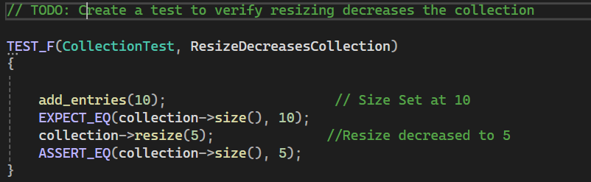
Unit Testing
Positive Test: ResizeDecreaseCollection:
Tests that resizing a collection of size 10 down to 5 correctly reduces its size.
Notes:
Unit Test Help Us Detect vulnerabilities and errors in code early in the development process. Here are some example positive and negative Tests:
Positive Test: ResizeDecreaseCollection:
Tests that resizing a collection of size 10 down to 5 correctly reduces its size.

Slide 9
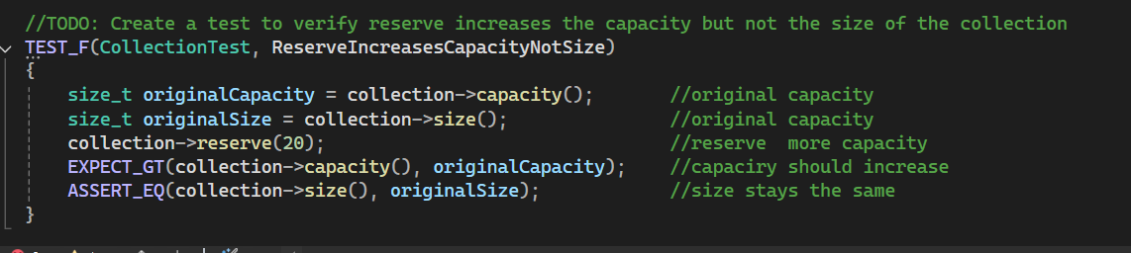
Unit Testing
Positive Test: ReserveIncreasesCapacityNotSize
Tests that reserving more capacity increases capacity() but does not increase size().
Notes:
Positive Test: ReserveIncreasesCapacityNotSize
Tests that reserving more capacity increases capacity() but does not increase size().

Slide 10
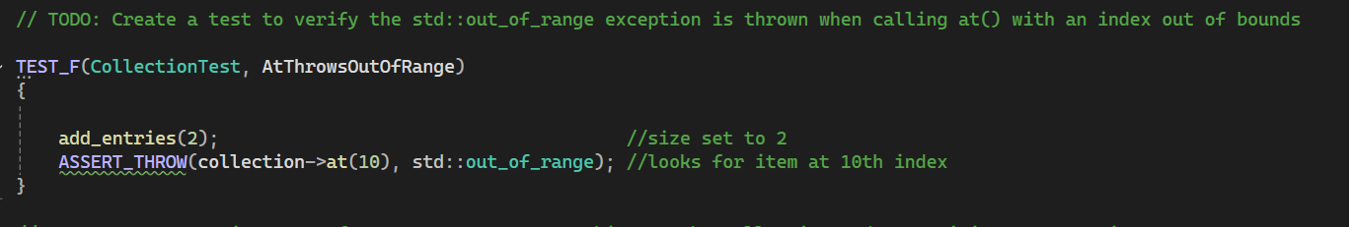
Unit Testing
Negative Test: AtThrowsOutOfRange
Tests that calling at() with an out-of-bounds index throws an std::out_of_range exception.
Notes:
Negative Test: AtThrowsOutOfRange
Tests that calling at() with an out-of-bounds index throws an std::out_of_range exception.

Slide 11
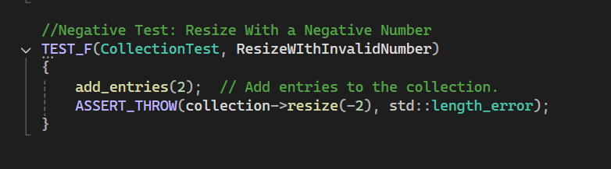
Unit Testing
Negative Test: ResizeWithInvalidNumber
Tests if resizing with a negative number throws an error.
Notes:
Negative Test: ResizeWithInvalidNumber
Tests if resizing with a negative number throws an error.

Slide 12

AUTOMATION SUMMARY
Notes:
DevSecOps is a workflow methodology that integrates security practices into every phase of the software development lifecycle, ensuring that security is considered from the initial design stages through development, deployment, and maintenance.

Slide 13
Importance of Automation
Automation is a critical component of any effective DevSecOps process. The current infrastructure could significantly benefit from implementing various automation techniques. A well-designed DevSecOps automation strategy should aim to fully automate most testing procedures, including code analysis, configuration management, and patching and vulnerability management. Several frameworks support automated testing. For instance, BeEF (Browser Exploitation Framework) can be used for browser-based security testing, while SQLMap is a powerful tool for detecting SQL injection vulnerabilities. These tools help identify and mitigate risks early in the development cycle.

Slide 14
TOOLS
Tools Used in a Dev Sec Op Pipeline:
Jenkins: An open-source automation server used to build, test, and deploy software continuously.
GitLab CI/CD: A built-in GitLab toolchain for automating the software delivery process using pipelines.
SonarQube: A platform that continuously inspects code quality and detects bugs, vulnerabilities, and code smells.
OWASP ZAP: An open-source security tool for finding vulnerabilities in web applications through automated scanning.
Terraform: An open-source Infrastructure as Code (IaC) tool used to provision and manage cloud infrastructure.
Notes:
There are many tools that help with automation in a DevSecOp pipeline, here are some popular ones:

Slide 15
RISKS AND BENEFITS
Act Now Or Wait
The longer it takes to detect and mitigate vulnerabilities, the more time attackers have to exploit them. Delayed action increases the spread of unauthorized access and the overall damage done to systems, data, and reputation.
Acting immediately through automated threat detection and mitigation systems allows organizations to:
Identify and isolate vulnerabilities early.
Reduce the attack surface.
Limit the impact of security breaches.
Maintain trust with stakeholders and users.
Risks:
Overwhelming Alerts
False Positives
Insufficient Planning
Notes:
When it comes to risk, we recommend acting as quickly as possible.
The longer it takes to detect and mitigate vulnerabilities, the more time attackers have to exploit them. Delayed action increases the spread of unauthorized access and the overall damage done to systems, data, and reputation.

Slide 16
RECOMMENDATIONS
Does Not Address Everything:
The current security policy may not comprehensively cover all aspects of the organization's digital and physical environment.
Employee Training and Physical Asset Protection
There is no mention of employee training and how employees should act against threat such email phasing attacks.
Mult Factor Authentication
While authentication is mentioned, The security policy does not go into details on how important, MFA is for all critical systems or accounts.
Cloud Infrastructure
The policies do not properly discuss how to protect cloud infrastructure
Artificial Intelligence
The current policies do not address how artificial intelligence (AI) can be exploited by hackers, nor do they outline how AI can be leveraged by the company to enhance cybersecurity and defend against threats.
Notes:
Our policies do not include everything, here are some further recommendations:

Slide 17
CONCLUSIONS
For Future Improvements:
Cloud Protection:
Cloud environments store vast amounts of data, including personal information, financial records, and intellectual property. Without strong cloud security, this data is vulnerable to breaches, leaks, or theft.
Artificial Intelligence:
AI can analyze massive volumes of network traffic and user behavior in real-time. It is able to learn hacker’s attack patterns, it can understand what a suspicious behavior is from normal behavior in a way that is intuitive and complex. It can detect suspicious activities such as:
Unusual login patterns
Data exfiltration attempts
Access anomalies across time zones or locations
This means faster detection and response than traditional methods.
Notes:
To conclude I would highly advocate for these two policies:

Slide 18
REFERENCES
Seacord, R. C. (2023). EXP33-C. Do not read untrusted data into a new object of a polymorphic type. SEI CERT C Coding Standard. Carnegie Mellon University Software Engineering Institute. Retrieved April 20, 2025, from https://wiki.sei.cmu.edu/confluence/pages/viewpage.action?pageId=88046682
StrongDM. (2025, April 17). What is AAA Security? Authentication, Authorization, and Accounting. StrongDM. Retrieved April 20, 2025, from https://www.strongdm.com/blog/aaa-security
StrongDM. (n.d.). What is encryption?. Retrieved April 20, 2025, from https://www.strongdm.com/blog/encryption-policy

